Slide 1
Analytical Dynamics Project 2 Double Link Pendulum Dynamics Simulation
By
Deepak Raina (2019MEZ8497)
Sandeep Kumar (2019MEZ8423)

Slide 2
Outline
Problem Statement
Equation of Motion (EoM)
Conversion to reduced order EoM
Differential Equation Solver
Simulation Results
Analysis

Slide 3
Problem Statement
To simulate dynamics of double link pendulum under the effect of gravity
Considering two point masses
Considering two rods
With or without torsional spring
Linearizing the equation of motion

Slide 4
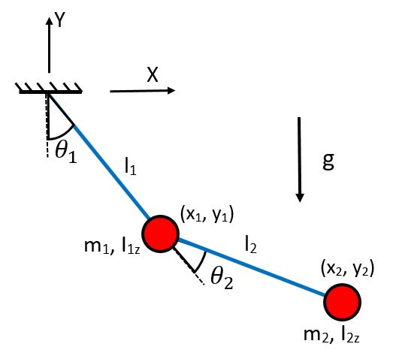
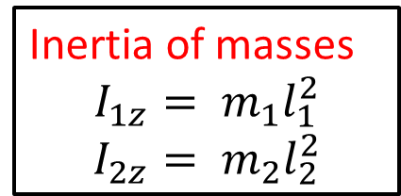
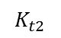
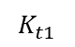
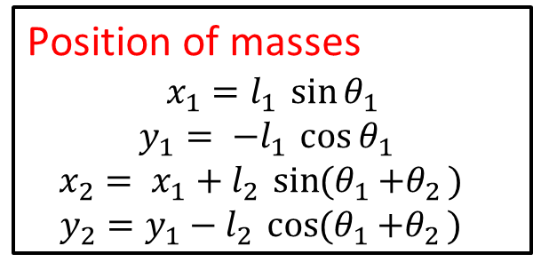
Case I: With 2 point masses
Assumptions:
Massless rods
Planar motion
$$K_{t1}$$
Inertia of masses
$$I_{1z}= m_{1}l_{1}^{2}$$
$$I_{2z}= m_{2}l_{2}^{2}$$
$$K_{t2}$$
Position of masses
$$x_{1}=l_{1 }\sin{θ_{1}}$$
$$y_{1}= {−l}_{1 }\cos{θ_{1 }}$$
$$x_{2}= {x_{1}+l}_{2 }\sin{{(θ}_{1 }+θ_{2 }) }$$
$$y_{2}={y_{1}−l}_{2 }\cos{{(θ}_{1 }+θ_{2 }) }$$

Slide 5
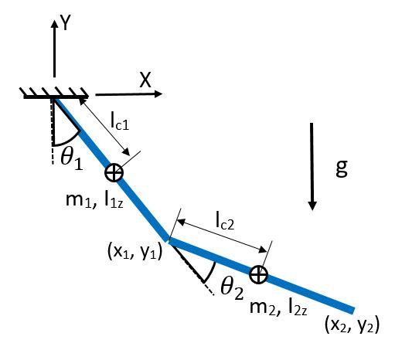
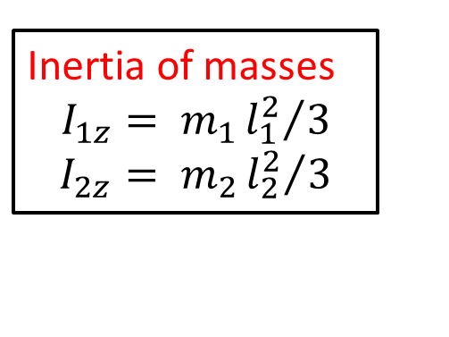
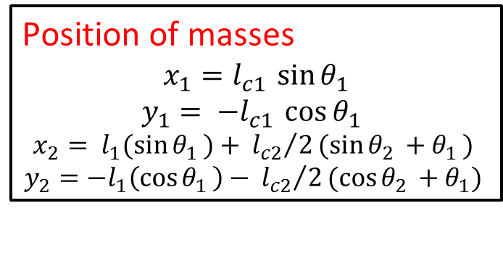
Case II: With 2 rods
Assumptions:
COM lies at center of link
Inertia of masses
$$I_{1z}= m_{1}{l_{1}^{2}}/3$$
$$I_{2z}= m_{2}{l_{2}^{2}}/3$$
Position of masses
$$x_{1}=l_{c1 }\sin{θ_{1}}$$
$$y_{1}= {−l}_{c1 }\cos{θ_{1 }}$$
$$x_{2}= {l_{1}(\sin{θ_{1 }})+}_{ }{l_{c2}}/2(sin{θ_{2 }+θ_{1 }) }$$
$$y_{2}=−{l_{1}\left(\cos{θ_{1 }}\right)−}_{ }{l_{c2}}/2(cos{θ_{2 }+θ_{1}) }$$

Slide 6
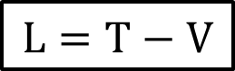
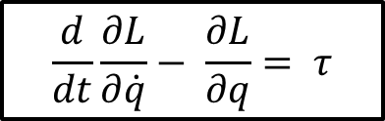
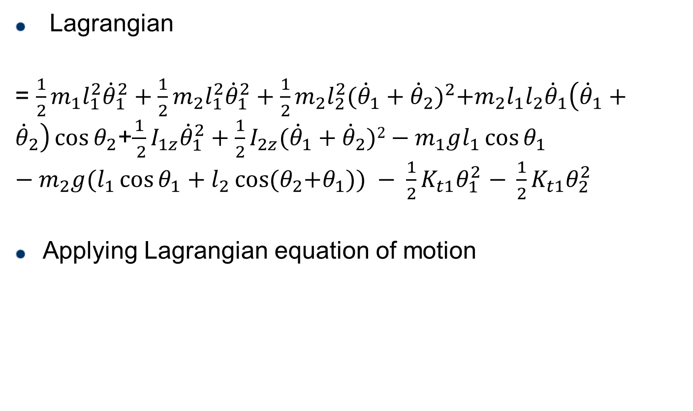
Equation of Motion (EoM)
Lagrangian
= $\frac{1}{2}m_{1}l_{1}^{2}{\dot{θ}}_{1}^{2}+\frac{1}{2}m_{2}l_{1}^{2}{\dot{θ}}_{1}^{2}+\frac{1}{2}m_{2}l_{2}^{2}{({\dot{θ}}_{1}+{\dot{θ}}_{2})}^{2}+m_{2}l_{1}l_{2}{\dot{θ}}_{1}\left({\dot{θ}}_{1}+{\dot{θ}}_{2}\right)\cos{θ_{2}}$+$\frac{1}{ 2}I_{1z}{\dot{θ}}_{1}^{2}+\frac{1}{2}I_{2z}({\dot{θ}}_{1}+{\dot{θ}}_{2})2−m_{1}gl_{1}\cos{θ_{1}}$ $−m_{2}g(l_{1}\cos{θ_{1}+l_{2}\cos{{(θ}_{2}+θ_{1}))}} − \frac{1}{2}K_{t1}θ_{1}^{2}$ $− \frac{1}{2}K_{t1}θ_{2}^{2}$
Applying Lagrangian equation of motion
$$L=T−V$$
$$\frac{d}{dt}\frac{∂L}{∂\dot{q}}− \frac{∂L}{∂q}= τ$$

Slide 7
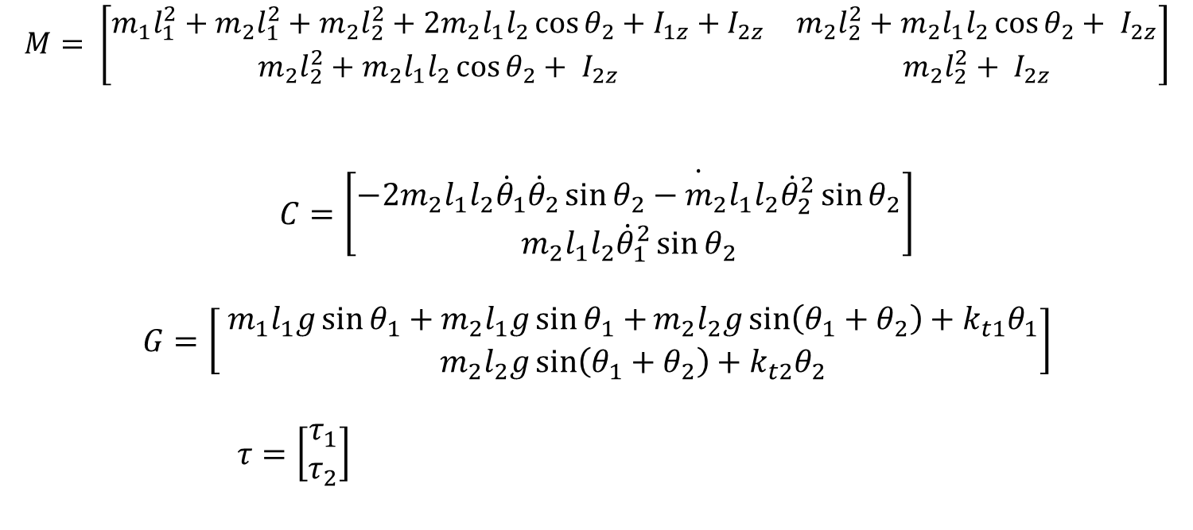

Equation of Motion (EoM)
$$M\left(q\right)\ddot{q}+C\left(q,\dot{q}\right)+G\left(q\right)= τ$$
Where, q = ${\begin{matrix}{[θ}_{1} & θ_{2}]\end{matrix}}^{T}$
$$M= \left[\begin{matrix}m_{1}l_{1}^{2}+m_{2}l_{1}^{2}+m_{2}l_{2}^{2}+2m_{2}l_{1}l_{2}\cos{θ_{2}+I_{1z}+I_{2z}} & m_{2}l_{2}^{2}+m_{2}l_{1}l_{2}\cos{θ_{2}+ I_{2z}} \\ m_{2}l_{2}^{2}+m_{2}l_{1}l_{2}\cos{θ_{2}+ I_{2z}} & m_{2}l_{2}^{2}+ I_{2z}\end{matrix}\right]$$
$$C=\left[\begin{matrix}−2m_{2}l_{1}l_{2}\dot{{\dot{θ}}_{1}{\dot{θ}}_{2}\sin{θ_{2}}−m_{2}l_{1}l_{2}{\dot{θ}}_{2}^{2}\sin{θ_{2}}} \\ m_{2}l_{1}l_{2}{\dot{θ}}_{1}^{2}\sin{θ_{2}}\end{matrix}\right]$$
$$G=\left[ \begin{matrix}m_{1}l_{1}g\sin{θ_{1}+m_{2}l_{1}g\sin{θ_{1}+}m_{2}l_{2}g\sin\left(θ_{1}+θ_{2}\right)+k_{t1}θ_{1}} \\ m_{2}l_{2}g\sin\left(θ_{1}+θ_{2}\right)+k_{t2}θ_{2}\end{matrix}\right]$$
$τ=\left[\begin{matrix}τ_{1} \\ τ_{2}\end{matrix}\right]$

Slide 8
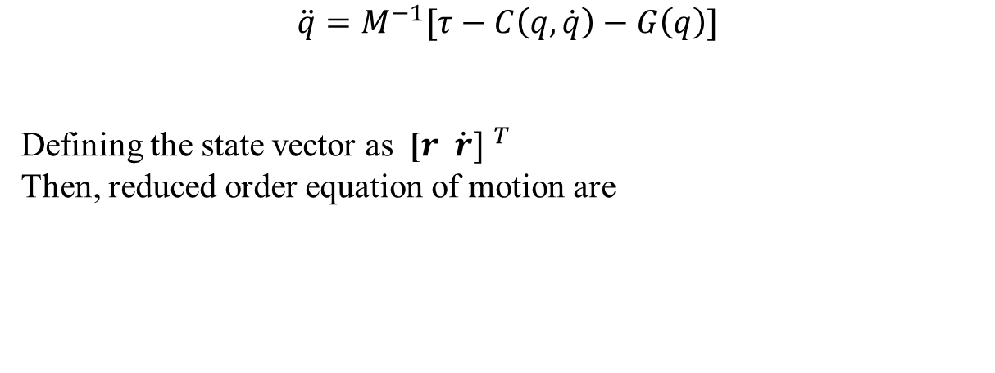
Reduced order EoM
$$M\left(q\right)\ddot{q}+C\left(q,\dot{q}\right)+G\left(q\right)= τ$$
$$\ddot{q}=M^{−1}[τ−C\left(q,\dot{q}\right)−G\left(q\right)]$$
Defining the state vector as ${\text{[}r \dot{r}] }^{T}$
Then, reduced order equation of motion are
Where ${q=[θ_{1 }θ_{2}]}^{T}$

Slide 9
Differential Equation Solver
ODE45:
This function implements a Runge-Kutta method
Syntax
[t,x] = ode45(@f_name, t_span, x_init, options)
Equations
ODE45
Output
Initial conditions

Slide 10
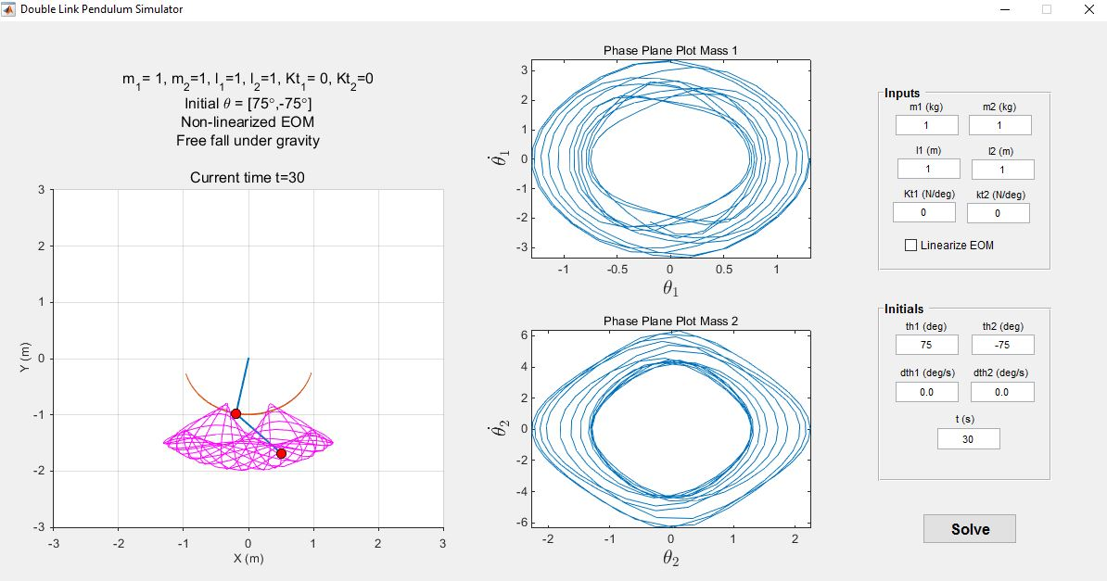
MATLAB GUI

Slide 11
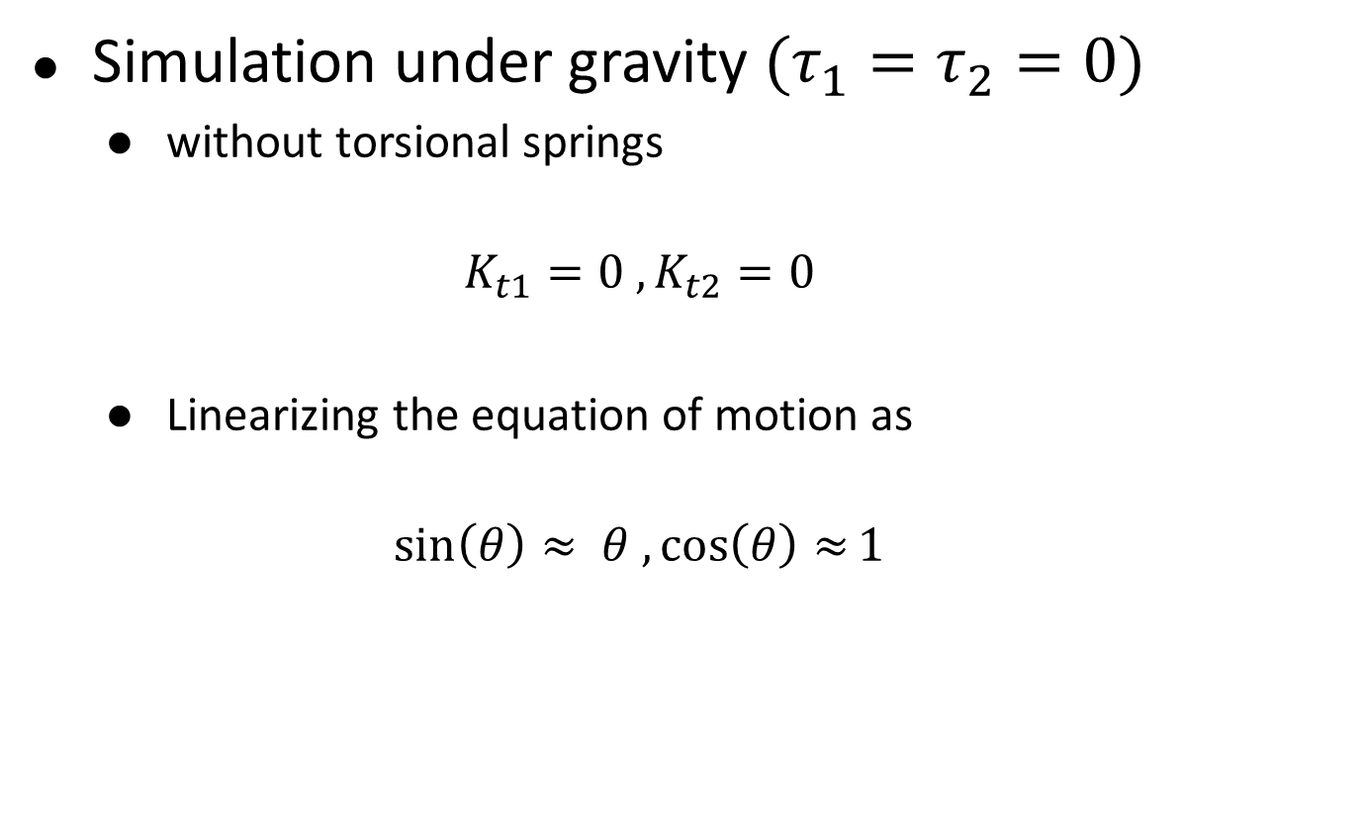
Simulation Results – for 2 point mass
Simulation under gravity $(τ_{1}=τ_{2}=0)$
without torsional springs
$$K_{t1}=0 ,K_{t2}=0$$
Linearizing the equation of motion as
$$\sin\left(θ\right)≈ θ , \cos\left(θ\right)≈1$$

Slide 12
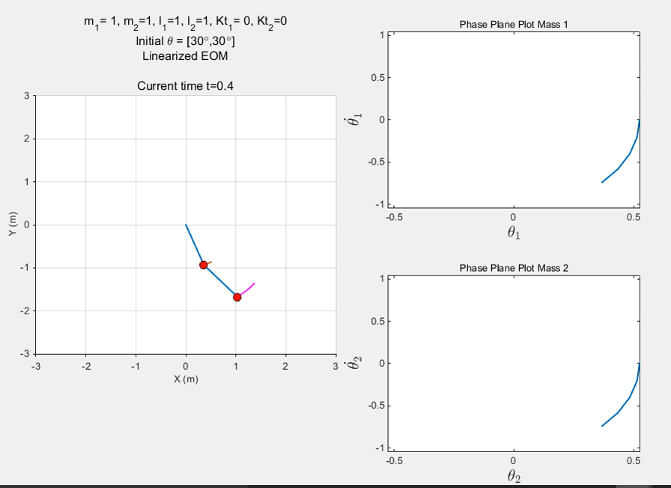

Slide 13
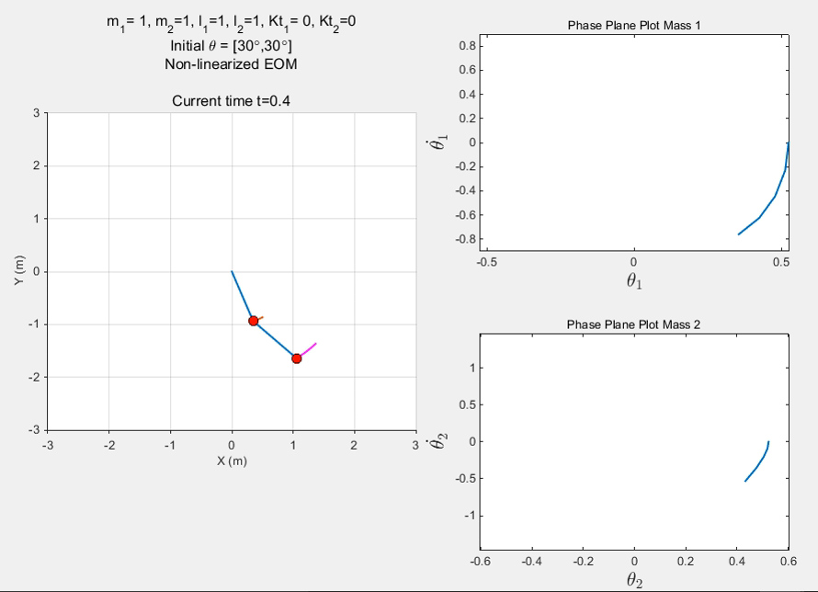

Slide 14
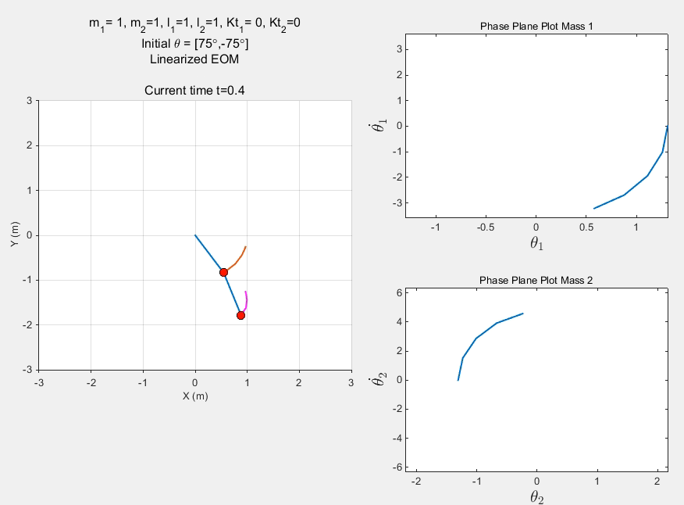

Slide 15
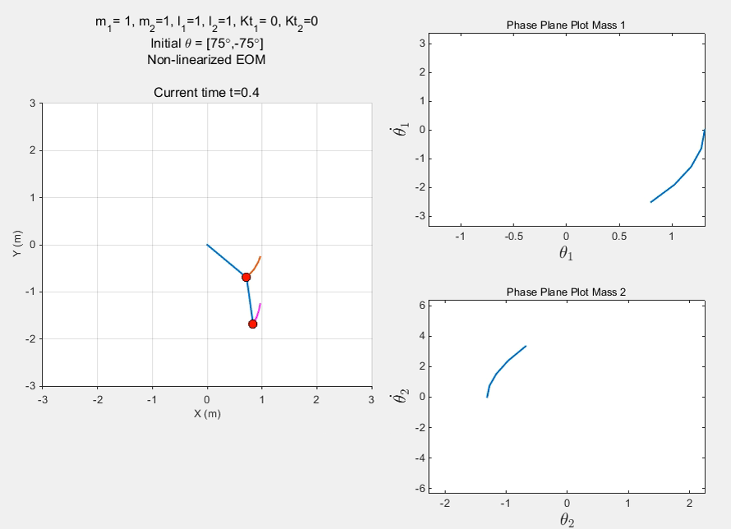

Slide 16
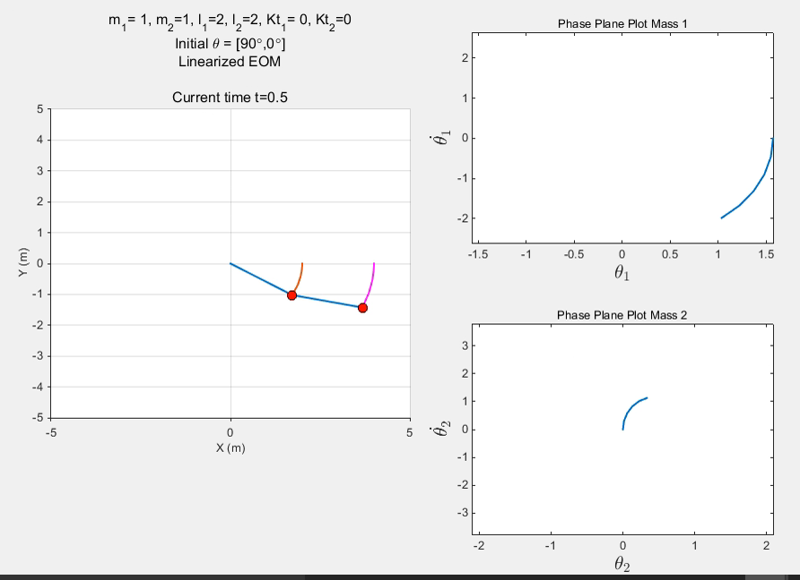

Slide 17
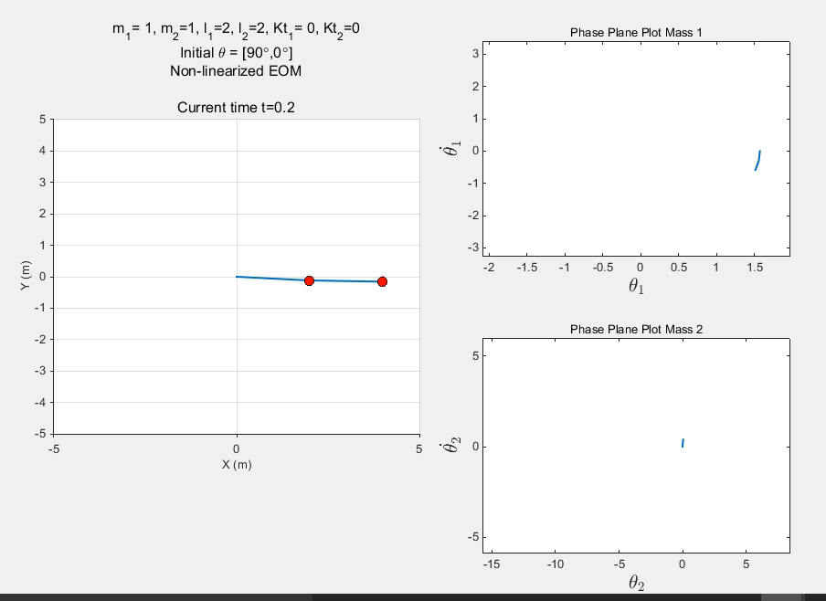

Slide 18
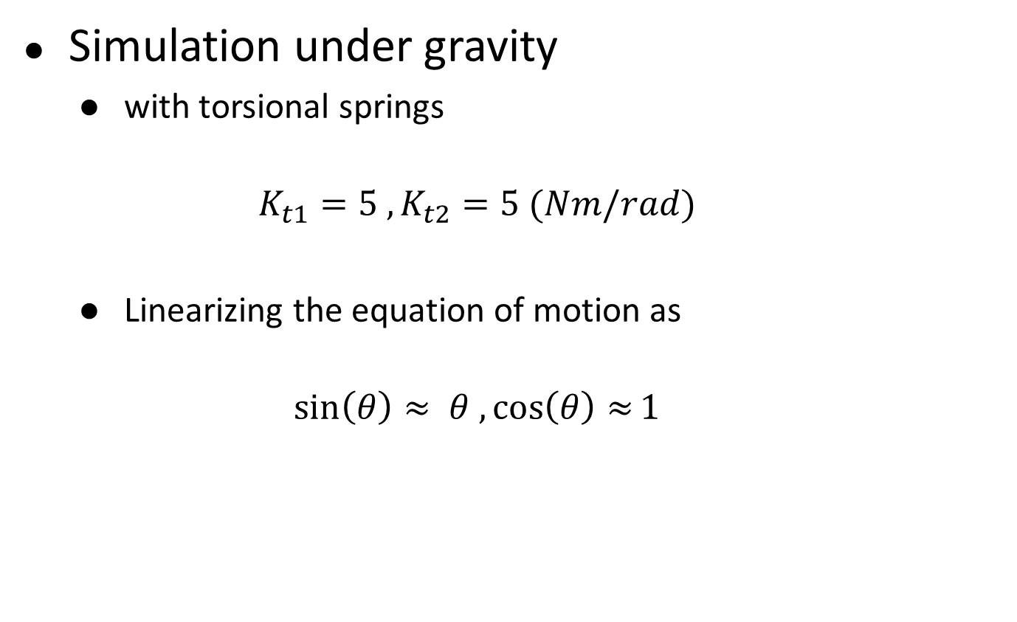
Simulation Results
Simulation under gravity
with torsional springs
$$K_{t1}=5 ,K_{t2}=5 (Nm/rad)$$
Linearizing the equation of motion as
$$\sin\left(θ\right)≈ θ , \cos\left(θ\right)≈1$$

Slide 19
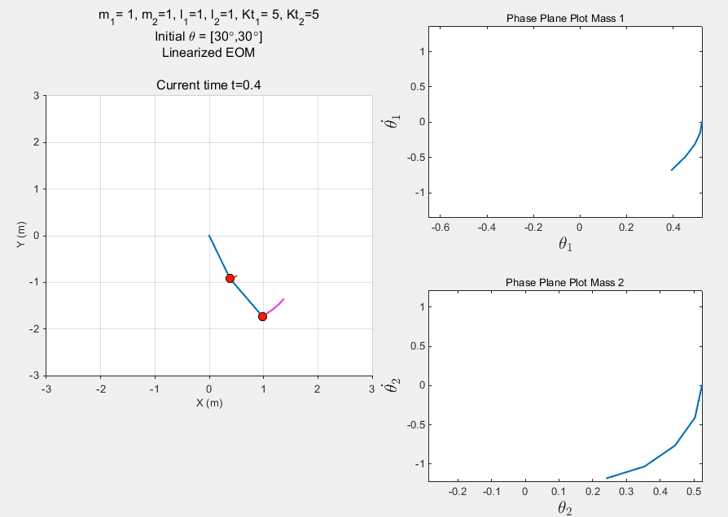

Slide 20
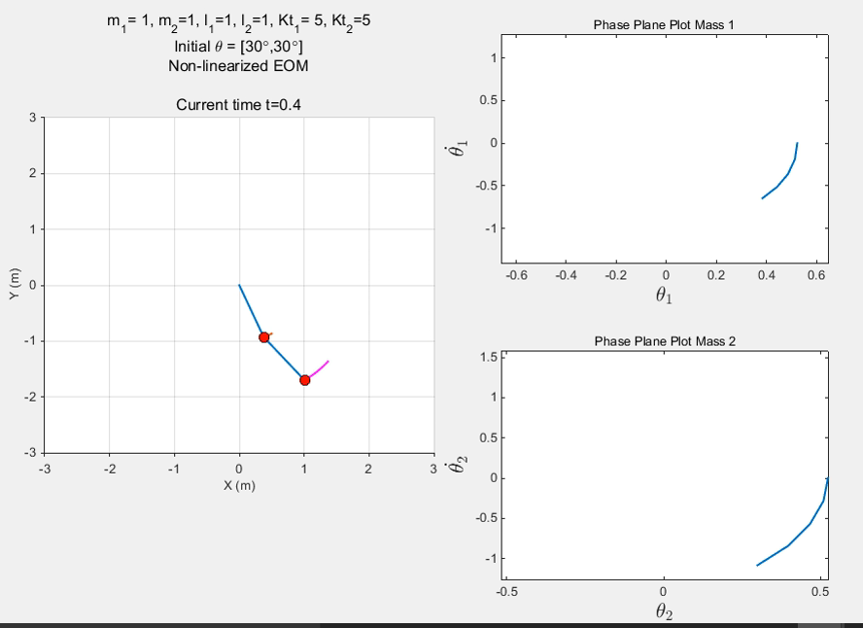

Slide 21
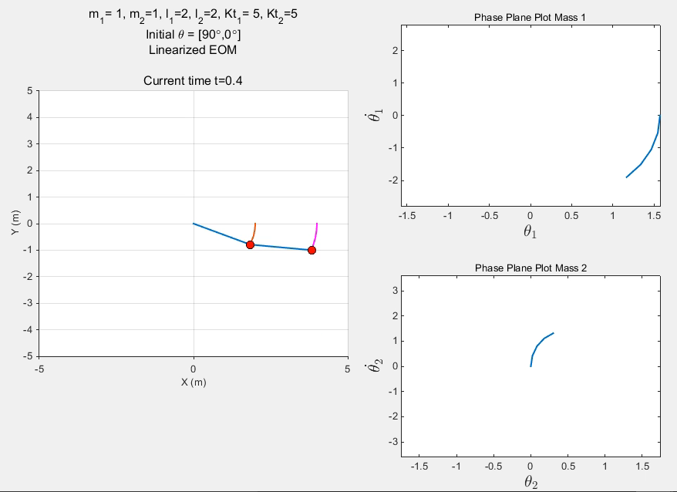

Slide 22
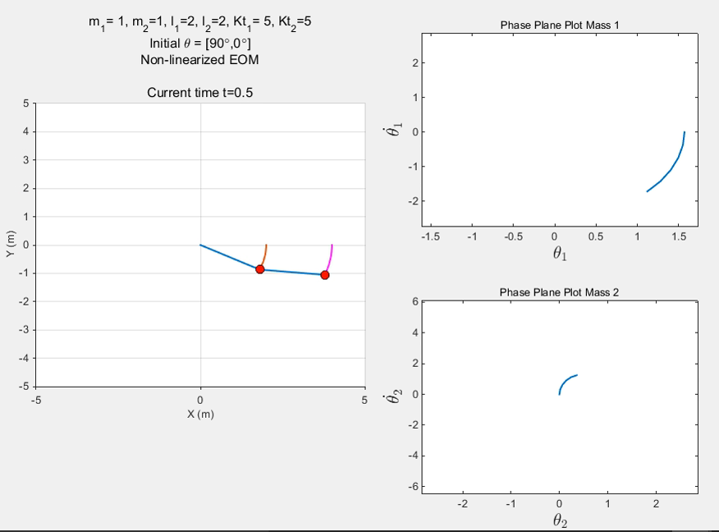

Slide 23
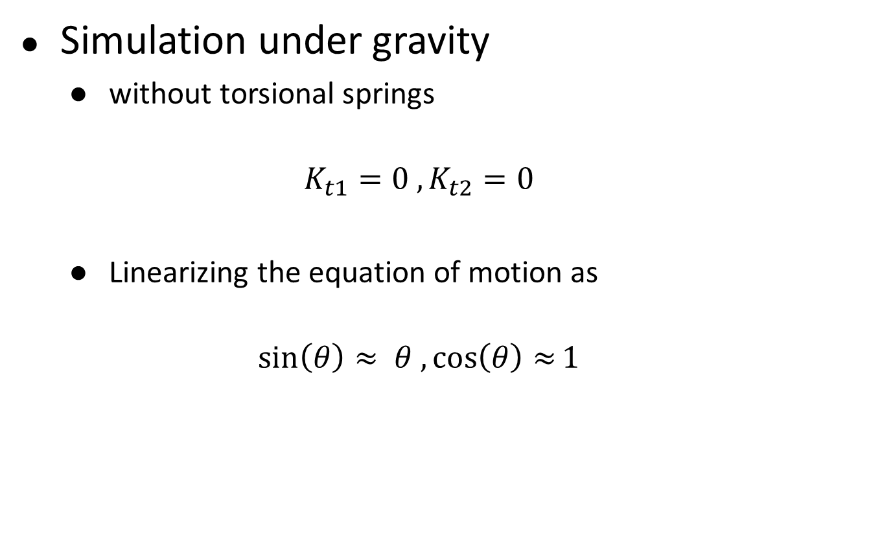
Simulation Results – for 2 rods
Simulation under gravity
without torsional springs
$$K_{t1}=0 ,K_{t2}=0$$
Linearizing the equation of motion as
$$\sin\left(θ\right)≈ θ , \cos\left(θ\right)≈1$$

Slide 24
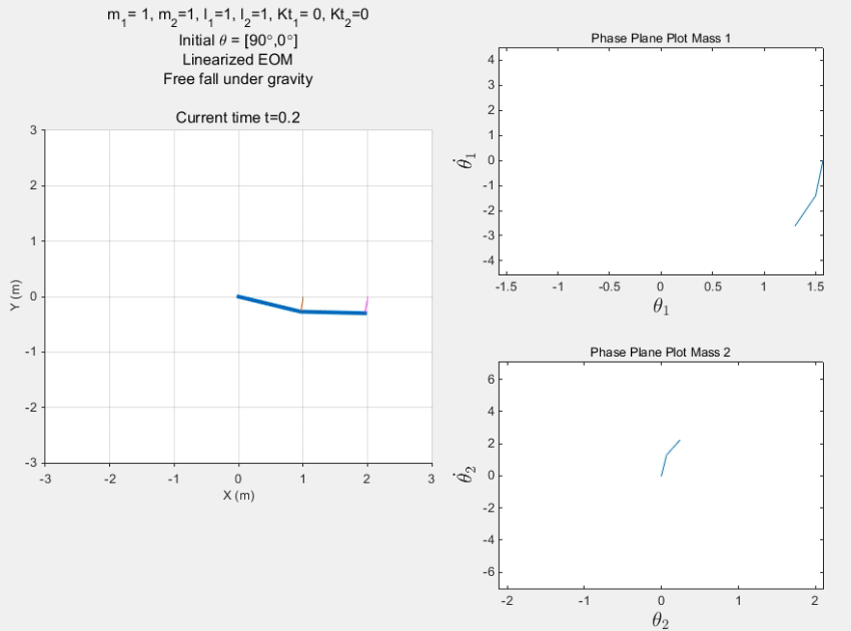

Slide 25
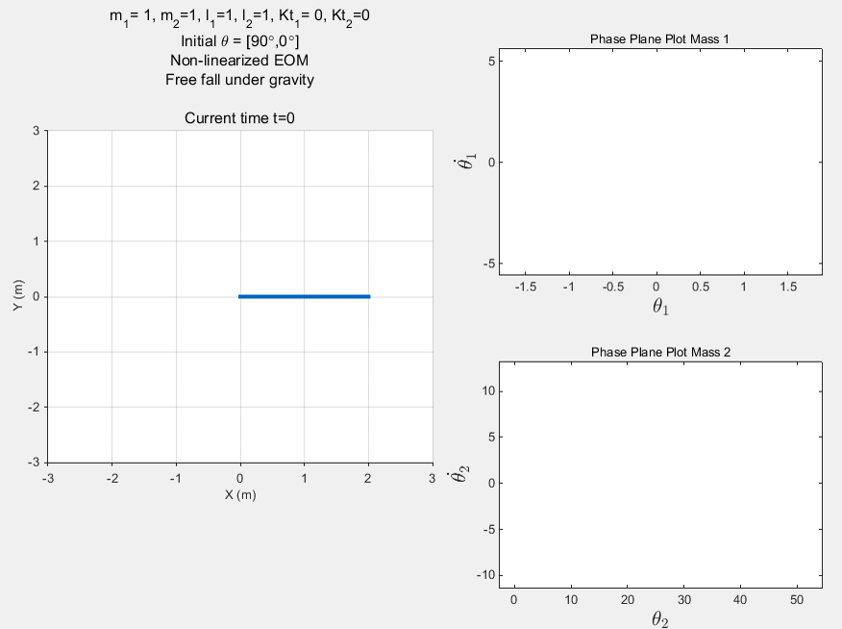

Slide 26
Analysis of simulations
For small angles, chaotic motion is absent, for large angle chaos motion is present.
For non-linearized case, there is more random motion otherwise its smooth.
Presence of torsional spring restrict the large value of angles, hence prevents chaotic motion.
Chaotic behavior
Small changes in initial conditions can lead to large changes in the long-term behavior of the system
Motion of the system is difficult to predict
Double pendulum is a chaotic system

Slide 27
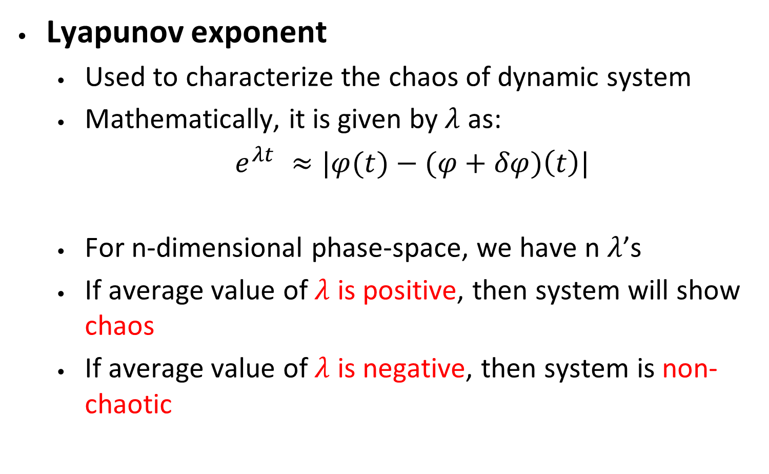
Prediction of Chaotic Behavior
Lyapunov exponent
Used to characterize the chaos of dynamic system
Mathematically, it is given by$λ$ as:
$e^{λt} ≈|φ(t)−(φ+δφ)\left(t\right)|$
For n-dimensional phase-space, we have n $λ$’s
If average value of $λ$ is positive, then system will show chaos
If average value of $λ$ is negative, then system is non-chaotic
Reference: Levien, R. B., and S. M. Tan. "Double pendulum: An experiment in chaos." American Journal of Physics 61.11 (1993): 1038-1044.

Slide 28
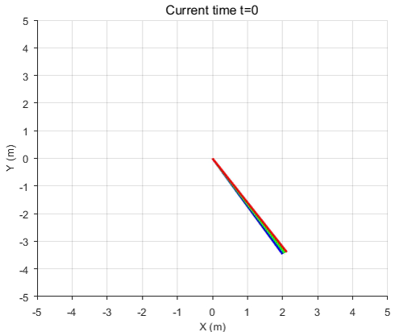
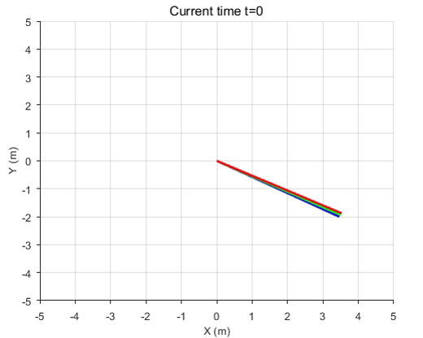
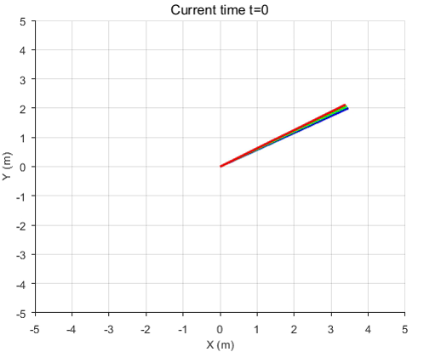
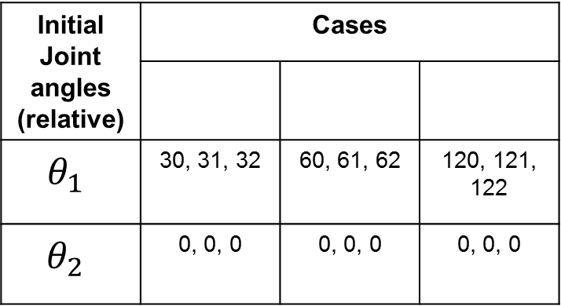
Effect of initial condition
1
2
3
Initial Joint angles (relative) | Cases
$$θ_{1}$$ | 30, 31, 32 | 60, 61, 62 | 120, 121, 122
$$θ_{2}$$ | 0, 0, 0 | 0, 0, 0 | 0, 0, 0
1
2
3

Slide 29
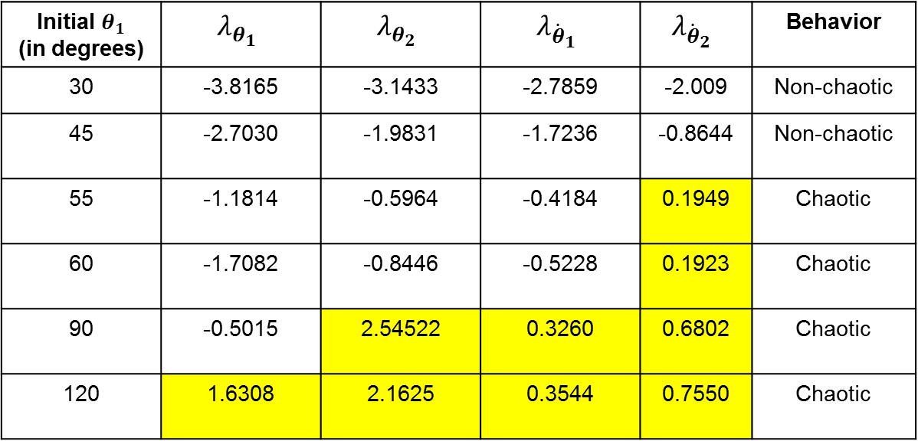
Analysis of chaotic behavior
Effect of initial condition:
Varying initial angle of first link
$m_{1}=1, m_{2}=1$, $l_{1}=1$, $l_{2}=1,θ_{2}= {\dot{θ}}_{1}={\dot{θ}}_{2}=0, t=100s$
Initial $θ_{1}$ (in degrees) | $$λ_{θ_{1}}$$ | $$λ_{θ_{2}}$$ | $$λ_{{\dot{θ}}_{1}}$$ | $$λ_{{\dot{θ}}_{2}}$$ | Behavior
30 | -3.8165 | -3.1433 | -2.7859 | -2.009 | Non-chaotic
45 | -2.7030 | -1.9831 | -1.7236 | -0.8644 | Non-chaotic
55 | -1.1814 | -0.5964 | -0.4184 | 0.1949 | Chaotic
60 | -1.7082 | -0.8446 | -0.5228 | 0.1923 | Chaotic
90 | -0.5015 | 2.54522 | 0.3260 | 0.6802 | Chaotic
120 | 1.6308 | 2.1625 | 0.3544 | 0.7550 | Chaotic

Slide 30
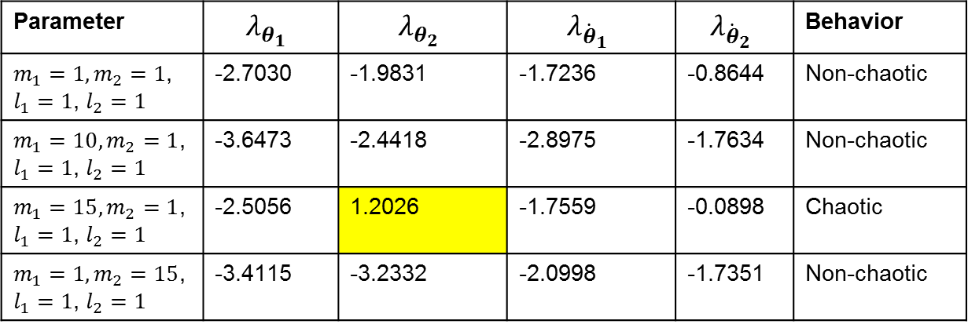
Analysis of chaotic behavior
Effect of initial condition:
Varying mass of links
$$θ_{1}=45 °,θ_{1}=0, {\dot{θ}}_{1}={\dot{θ}}_{2}=0, t=100s$$
Parameter | $$λ_{θ_{1}}$$ | $$λ_{θ_{2}}$$ | $$λ_{{\dot{θ}}_{1}}$$ | $$λ_{{\dot{θ}}_{2}}$$ | Behavior
$m_{1}=1, m_{2}=1$, $l_{1}=1$, $l_{2}=1$ | -2.7030 | -1.9831 | -1.7236 | -0.8644 | Non-chaotic
$m_{1}=10, m_{2}=1$, $l_{1}=1$, $l_{2}=1$ | -3.6473 | -2.4418 | -2.8975 | -1.7634 | Non-chaotic
$m_{1}=15, m_{2}=1$, $l_{1}=1$, $l_{2}=1$ | -2.5056 | 1.2026 | -1.7559 | -0.0898 | Chaotic
$m_{1}=1, m_{2}=15$, $l_{1}=1$, $l_{2}=1$ | -3.4115 | -3.2332 | -2.0998 | -1.7351 | Non-chaotic

Slide 31
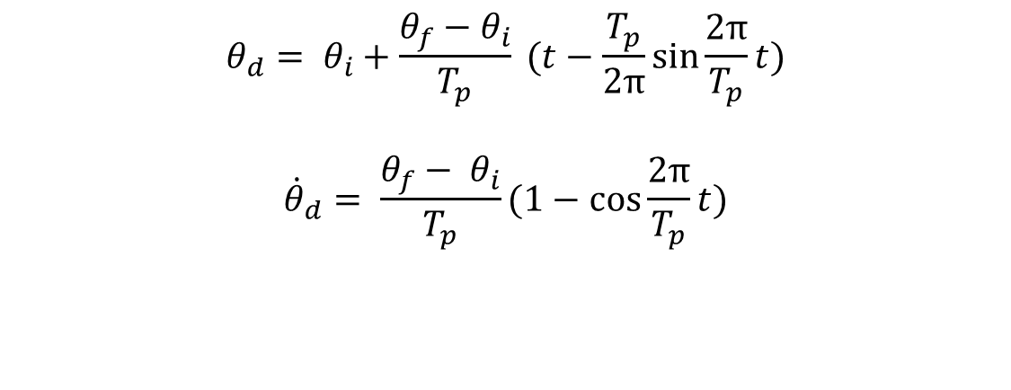
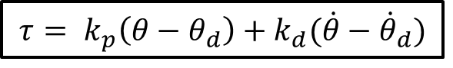
Extra Results
Forced Control
Applied Torque
Desired Trajectory: Cycloidal
$$τ= k_{p}\left(θ−θ_{d}\right)+k_{d}(\dot{θ}−{\dot{θ}}_{d})$$
$$θ_{d}= θ_{i}+\frac{θ_{f}−θ_{i}}{T_{p}} (t−\frac{T_{p}}{2π}\sin{\frac{2π}{T_{p}}t)}$$
$${\dot{θ}}_{d}= \frac{θ_{f}− θ_{i}}{T_{p}}(1−\cos{\frac{2π}{T_{p}}t)}$$

Slide 32
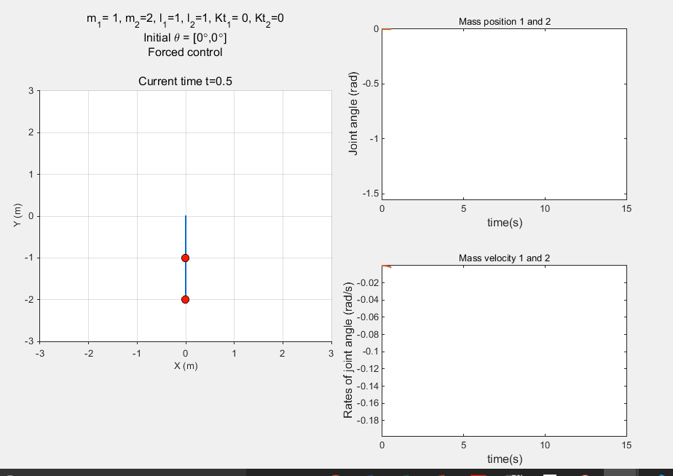
Simulation Results
Forced control:

Slide 33
Thank You

Slide 34
Some more results

Slide 35
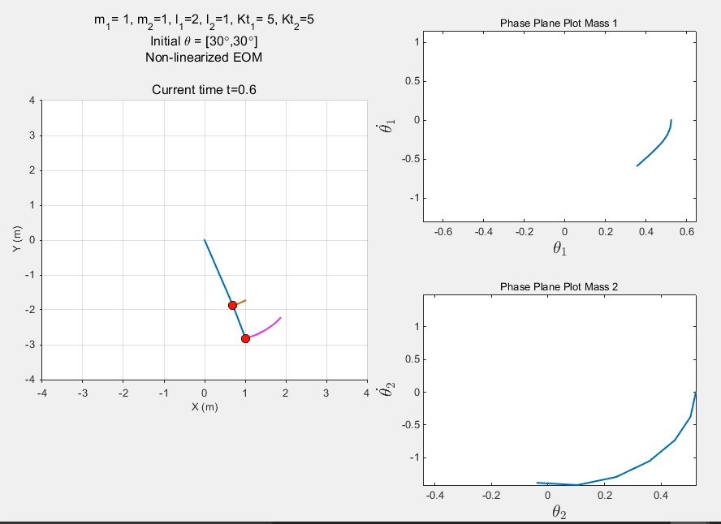
Some more results

Slide 36
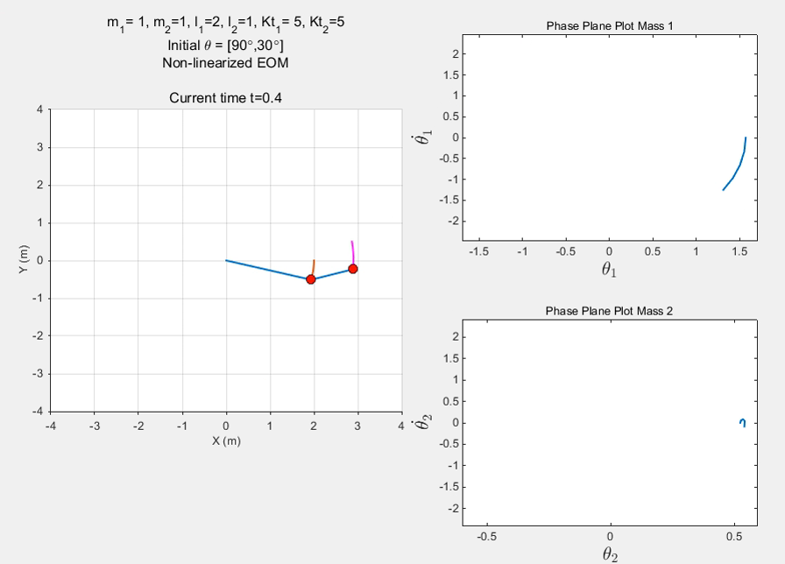
Some more results

Slide 37
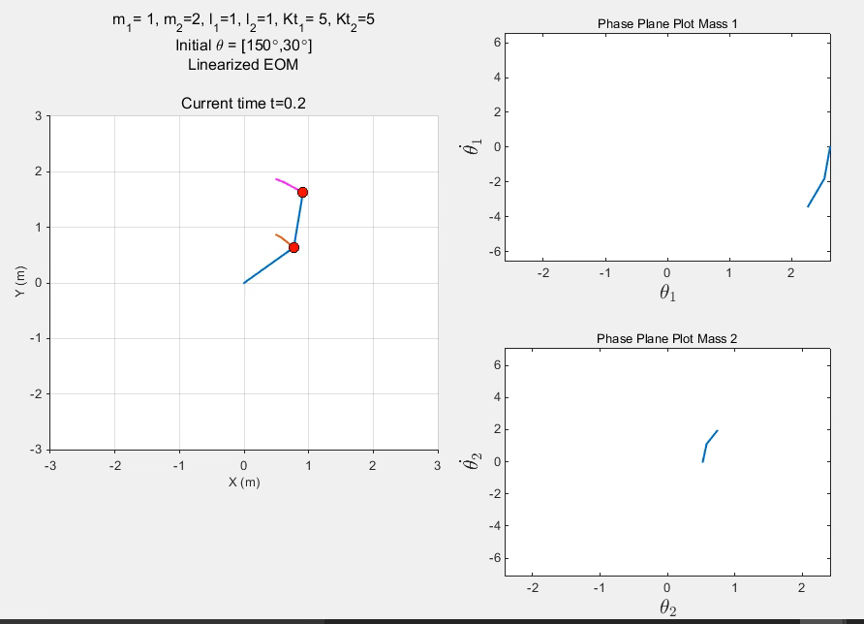
Some more results

